Slide 1
Oral Defence
Jonas Vinck, Clément Legein, Oscar Dekeukelaere, Benjamin van Halteren, Charlotte Jadoul

Slide 2

External partner: StarApps
StarApps is a start-up studio turning problem-solving ideas into successful companies.
Contactperson: Jeroen Vroman

Slide 3
Problem
Current situation for bailiffs:
Solvability checks are done manually
Information is spread over many sources
Takes a lot of time
Hard to quickly decide if a case is worth starting
=> Inefficient use of time and resources

Slide 4
Solution: Solv.io
What is Solv.io?
A web application that:
Uses basic debtor information
Instantly shows a solvability score
Also shows Risk & Credit Overview, Business Information…
Designed for bailiffs
Helps make faster and better decisions

Slide 5
MVP User Story
As a bailiff
I want to input a debtor’s basic identifiers (name, address, national ID) and instantly see a solvability score
-> So that I can decide in <1 minute whether to initiate recovery instead of spending hours on manual checks
I want a dashboard view with sortable debtor cases by solvability score
-> So that I can prioritize high-potential cases each morning

Slide 6
MVP User Story
Current situation:
roles field in the user table: Currently always NULL
Each user implicitly has only one role (baillif)
Simple extension:
A user can choose a role during registration
-> access to role-specific features immediately

Slide 7
The algorithm
Automatic business analysis based on VAT number or company name
Operation:
clean_vat_number
→ function to check whether a VAT number is valid
Identify companies
→ Detects Belgian VAT numbers
→ retrieves existing data from database or fetches new data via Bizzy API
upload_csv
→ function to read/import a CSV file

Slide 8
The algorithm
Operation (continued)
4. add_debtor function
→ Function to add a debtor either to an existing batch, create a new batch, or add it as a standalone debtor
5. Prioritize debtors
→ sorts batch by quick ratio
6. export_batch_pdf
→ function to export a PDF

Slide 9
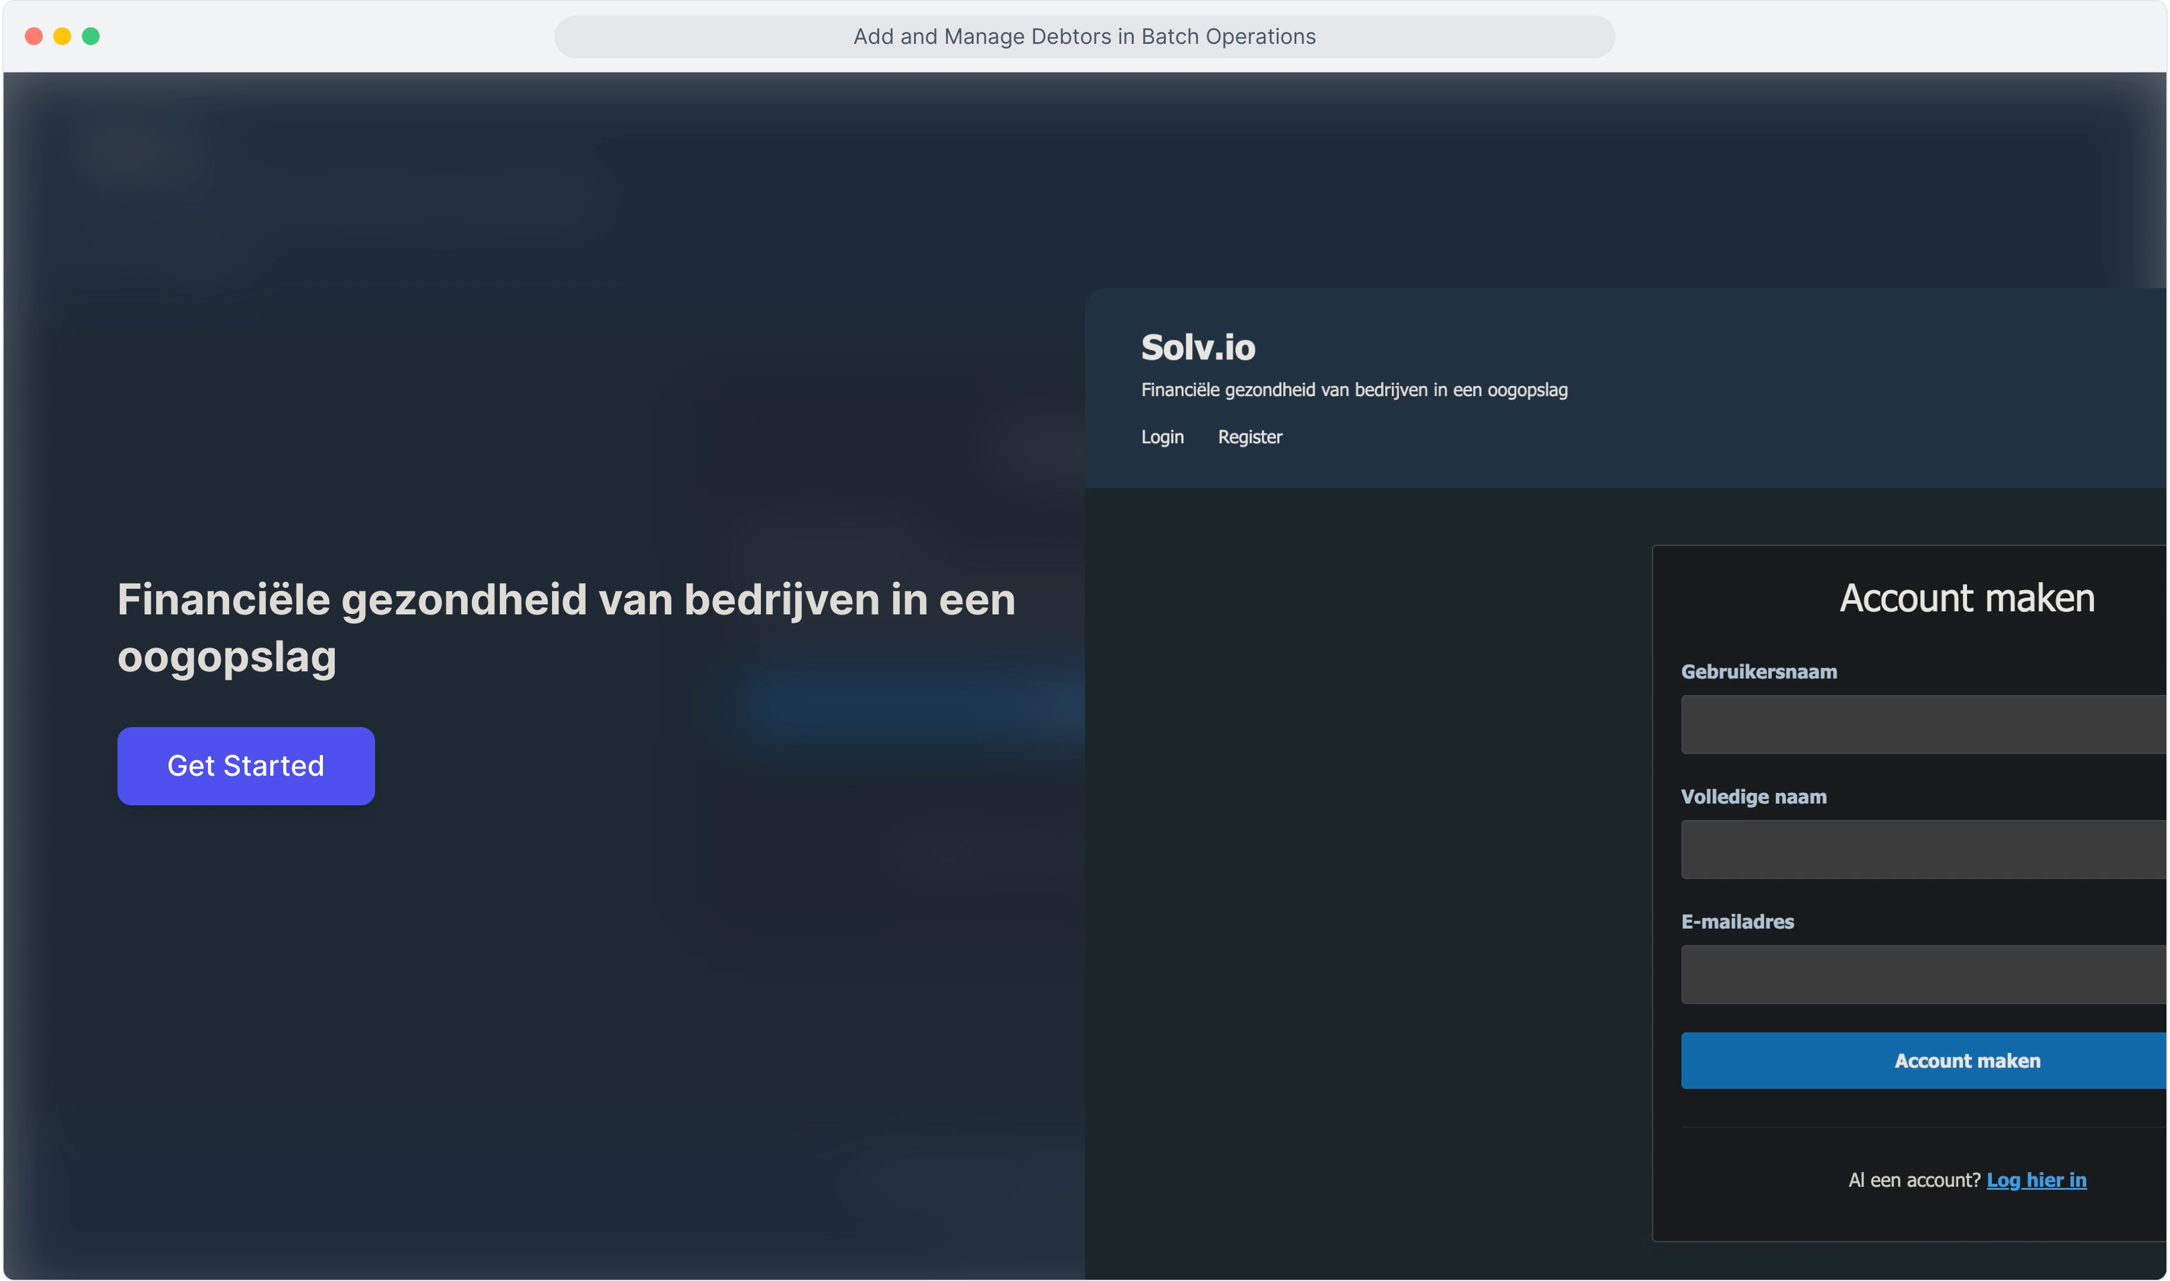
Demo

Slide 10
Best Practices
Separation of HTML & CSS
HTML and CSS are separated throughout the project
(Exception: batch_pdf.html)
Bootstrap
Used Bootstrap for a clean and professional layout + responsiveness
(test via Ctrl + Shift I and then Ctrl + Shift M)

Slide 11
Best Practices
No SQL queries used
Safe database interaction via ORM: SQLAlchemy (no SQL Injection)
Clear Flask Structure
Clear separation of :
HTML & CSS in separate files
Routes for functions
Separate file for API handling

Slide 12
Strengths and limitations
Strengths:
Prevents duplicates within a batch
Allows a batch to have a name and description
Sorts a batch based on quick ratio => logical
Limitations:
A company can only be searched by name if it is already in the database

Slide 13
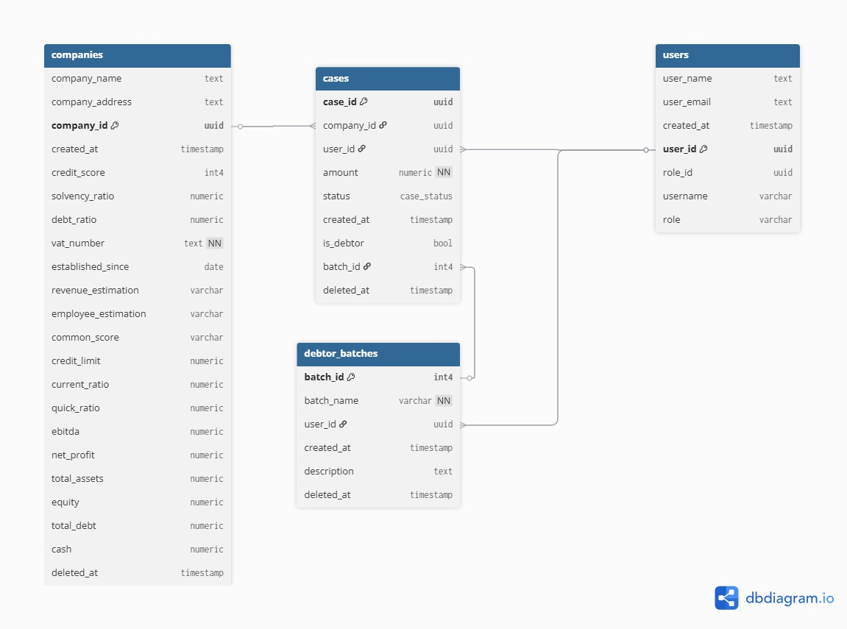
ERD model

